Slide 1
Quality Review of Tax Return
Pub 4012 – Tab K
Notes:
This presentation is designed for Instructors to develop Quality Review training to meet the needs of their various volunteers. The are far more slides than would be needed for certain volunteer groups. For example the first section may be useful for all volunteers, including some Client Facilitators. Many districts conduct comprehensive training for Designated Quality Reviewers so perhaps the entire presentation could be adapted for that training.

Slide 2
Lesson Topics
Principles of Quality Review (requirements and basic concepts of Quality Review)
Conducting a Quality Review – One Example
QR Saves the Day (real life examples)
Notes:
This presentation has three sections. The presentation can be broken up and modified depending on the volunteers being trained.
Slides 4-23 provide a general overview of quality review requirements and concepts including the proper review of the Intake/Interview (I&I) Sheet
Slides 24-48 provide an example of how to conduct a quality review using the TaxSlayer QR Print Set. This section discusses the Quality Review only, it does not cover the final steps of finishing the return. The final steps vary from district to district and even site to site, so Instructors will need to develop training materials to present that information to their volunteers.
Slides 49-62 Provide real life examples where a good QR “saved the day”

Slide 3
Learning Objectives
Learners will:
Understand why quality review is important
Explore benefits of quality review
Review basic quality review process
Learn one QR technique using QR Print Set
Review real life examples illustrating value of a good QR
Discuss Best Practices for Quality Review
Notes:
These learning objectives are presented in this entire presentation. Instructors will need to modify this slide as necessary depending on which section of this presentation they intend to present.

Slide 4
Principles of Quality Review
Accuracy is Job #1

Slide 5
QR = Accuracy – It’s a Fact
IRS reviews showed:
Volunteers who prepared returns using complete Intake/Interview and Quality Review Process achieved 98.65% accuracy rate
Volunteers using incomplete or non-existent Intake/Interview and Quality Review Process attained only 77% accuracy rate

Slide 6
Quality Review
Quality Review is more than proofreading exercise
Reviewer must:
Review Intake Booklet with the taxpayer
Update Intake Booklet if there are changes
Engage with taxpayer – ask questions to verify information
Evaluate overall return – do numbers make sense?
Can taxes be reduced for the taxpayer?
Notes:
Quality review has been a consistent weak area every year in IRS Site Reviews

Slide 7
Requirements
While methodology may differ site-to-site, these rules apply to all:
ALL returns must receive a quality review by second, independent certified Counselor
Quality review must be completed with taxpayer(s) present
Quality review takes place after return is prepared, before return is printed, and before taxpayer signs return
Notes:
Independent Counselor was not involved in return preparation other than perhaps answering a question or two
Counselors must be certified for the specific tax year when reviewing prior year returns.

Slide 8
Quality Review Methods
Designated reviewer – Best Practice
More experienced Counselor
Able to resolve more complicated tax issues
Peer review – Any second, independent Counselor review
Self-review – never acceptable
Notes:
Designated review can be done at the preparer’s computer or at a separate station as decided by the Local/Site Coordinator
However, it must always have the taxpayer present

Slide 9
Benefits for the Taxpayer
Prevent IRS notices/contacts
Calculation of correct tax, avoiding paying money back with interest and penalty
Receives all credits and deductions they are entitled to
Increase confidence in Tax-Aide service

Slide 10
Consequences of a Poor Quality Review
Notices from IRS are extremely stressful
No one enjoys being pen pals with IRS
Taxpayer hardship paying money back
Costly interests and penalties
Missed eligible credits or deductions

Slide 11
Benefits for the Counselor
Reduces anxiety knowing another Counselor “has your back”
Receiving feedback increases skills and builds confidence
Raises volunteer morale
Fosters teamwork

Slide 12
Benefits for the Site
Reduces e-file reject rates
Ensures compliance with Quality Site Requirements
Increases productivity, reduces rework (amended returns)
Gives taxpayers more confidence in site’s ability to prepare complete and accurate tax returns

Slide 13
Quality Review Resources
Quality Review resources
Gold Standards for Quality Review
AARP portal – Type “gold” in search box – in Libraries
Pub 4012 Tab K Basic Quality Review Process

Slide 14
Quality Review Process
The Quality Reviewer must verify:
All issues on tax return are within scope
Both tax preparer and reviewer are certified to complete the tax return for the tax year
All required entries in Intake Booklet were completed and marked Yes or No
Notes:
The Quality Reviewer should make corrections on the Intake Form if there are any noted during the QR interview

Slide 15
Keys to an Accurate Quality Review
Involve the taxpayer(s)
Thorough review of Intake Booklet
Careful review of tax return
All errors/deficiencies corrected
Compare with last year’s return (if available)

Slide 16
Involve Taxpayer
Review any issues that came up during preparation
Ask taxpayer(s) if they have any other income
Does taxpayer have any questions?
Make sure taxpayer understands that they are responsible for accuracy of their return
Notes:
Introduce yourself and explain the quality review process to taxpayer

Slide 17
Review Intake Booklet
Review preparer notes, changes, new information, clarifications, etc. on Intake Booklet
Parts I & II
Confirm most advantageous and correct Filing Status selected
All dependents claimed as Qualifying Children or Qualifying Relatives as appropriate
Dependent questions (gray section) answered
Notes:
Have note pad available to take notes on specific items to check like capital loss carryover.

Slide 18
Review Intake Booklet
Part III - Income
Tax documents match appropriate checked boxes
All “Unsure” or unmarked boxes resolved
All tax documents accounted for and entered
What do you always ask the taxpayer?
“Did you have any other income?”
Notes:
Instructor should ask learners

Slide 19
Review Intake Booklet
Part IV – Expenses
Only qualifying expenses entered on return
All available adjustments to income included
Appropriate deductions (standard or itemized and/or qualified business income) used to compute taxable income
All available credits applied to reduce total tax
Credits make sense (EITC, AOC, CTC, etc.)

Slide 20
Review Intake Booklet
Part V – Life Events
Confirm all events affecting return
Pay attention to estimated tax payments
Check for capital loss carryover
Infrequently seen items sometimes out-of-scope
Form 1095-A entered correctly for Marketplace coverage
Premium tax credits correctly reconciled on Form 8962
Notes:
Note that marketplace health care coverage was moved to this section

Slide 21
Review Intake Booklet
Additional Information
Note any direct deposit/direct debit
Check bank account information
Add additional notes if applicable

Slide 22
Notes
Notes to add to return in TaxSlayer (examples)
Missing form and taxpayer will return
Different spelling of name on social security card versus last year’s return
Power of attorney for absent taxpayer
Pension exclusion on Form 1099-R complete
Distribution fully taxable going forward
Notes:
Instructor should ask class for reasons to add a note

Slide 23
Bottom Line
Quality Review
More than a proofreading exercise
Insures an accurate return
Provides the lowest tax for taxpayer
Notes:
23

Slide 24
Conducting a Quality Review
One Example
Notes:
Counselors have various methods for conducting a quality review. The following slides provide an example of one QR method using the TaxSlayer QR Print Set. This presentation walks through the QR of a typical tax return for a young married couple with two dependents.
Note that the screenshots are from the 2018 TaxSlayer QR Print Set. There maybe slight changes for 2020. The purpose of this presentation is to familiarize volunteers with the QR Print Set and its use in conducting a Quality Review.

Slide 25
Conducting a Quality Review
Methods include:
Reviewing QR Print Set (recommended)
Retracing preparer’s steps
Reviewing Summary/Print and linking to input screens
Notes:
There is no one-size-fits-all process. For example, if the return is a very simple one, retracing the preparer’s steps is probably the most efficient and quickest way to review the return. Conversely, for a return that has multiple W-2s and/or 1099-Rs, it may be more effective use the QR Print set

Slide 26
Conducting a Quality Review
QR on computer rather than printed return
Incomplete/missing forms are apparent
Ease of updating errors
Saves paper and ink/toner
Notes:
There is no one-size-fits-all process. For example, if the return is a very simple one, retracing the preparer’s steps is probably the most efficient and quickest way to review the return. Conversely, for a return that has multiple W-2s and/or 1099-Rs, it may be more effective use the QR Print set

Slide 27
Quality Review Example
This example is for a typical tax return for a young married couple
MFJ with two dependent children (age 6 and 14)
Two W-2s (one with 401(k) contribution)
Unemployment
Child Care Payments
Notes:
The following slides illustrate the steps of a quality review using the QR Print Set

Slide 28
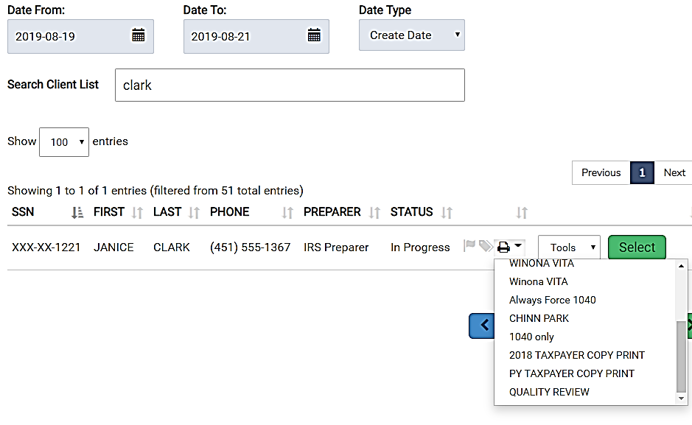
Quality Review Return PDF
Click
Select Quality Review
Notes:
One way to conduct QR is to select drop down arrow and then select [Quality Review] pdf from Office Client List
Best Practices
Have the Quality Review PDF open in one window
After opening the QR PDF, click SELECT to open the tax return in another window

Slide 29
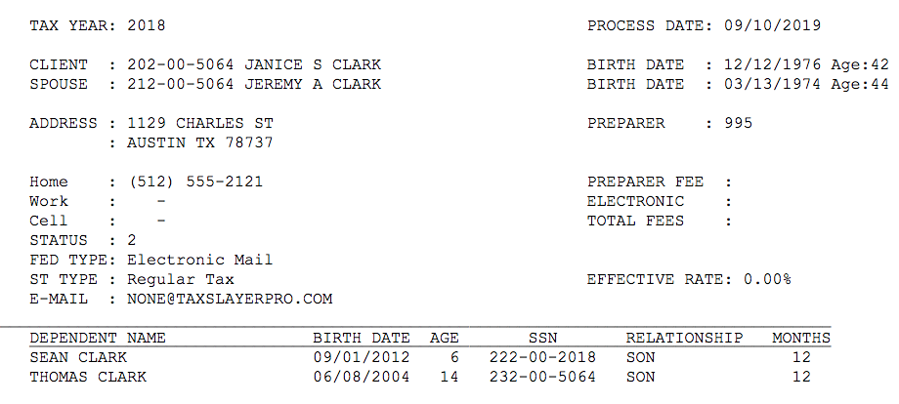
Personal Information Summary
Review and check for errors
Notes:
The taxpayer’s personal information can be checked using this summary page in the print set. Reviewing this page with the taxpayer while examining the Intake/Interview Sheet provides high confidence in accuracy of basic information
In some cases, the Quality Reviewer may need to verify certain check boxes such as disabled, full-time student, etc. but even some of those can be verified in other places such as Schedule EIC and on page 1 of the 1040.

Slide 30
Review Intake Booklet
What credits or forms might you expect to see?
Child Tax Credit (both Sean and Thomas)
Retirement Savings Credit (Form 8880)
Child Care Credit (only Sean, Form 2441)
Additional Child Tax Credit (Refundable, Form 8812)
Earned Income Credit (Refundable, Schedule EIC)
Notes:
Based on the scenario, have learners write down a list of possible credits for the Clarks. Then have them check how many they got right.
Instructor, ask learners: Which of these phase out at higher income levels?
Answer: Retirement Savings Credit and Earned Income Credit

Slide 31
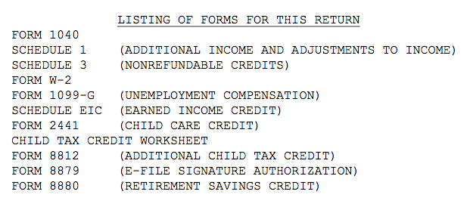
Listing of Forms
Verify list matches documents taxpayer has provided
Notes:
This PDF page provides a useful summary which should match with the taxpayer’s documents

Slide 32
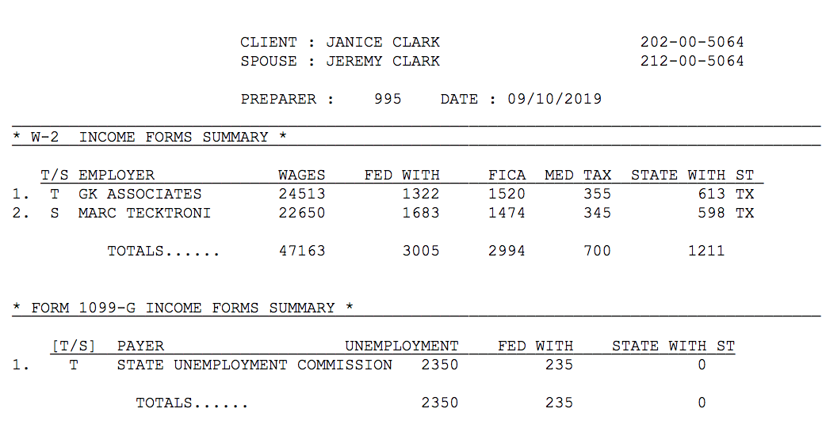
Verify Unemployment
Form 1099-G will not be displayed – verify the information here. Social Security benefits Form 1099-SSA also displayed on this screen
Notes:
A copy of any W-2s, 1099Rs, and 1099-MISC will appear in later pages of the print set. 1099-G and Form SSA-1099 information can be verified on this page

Slide 33
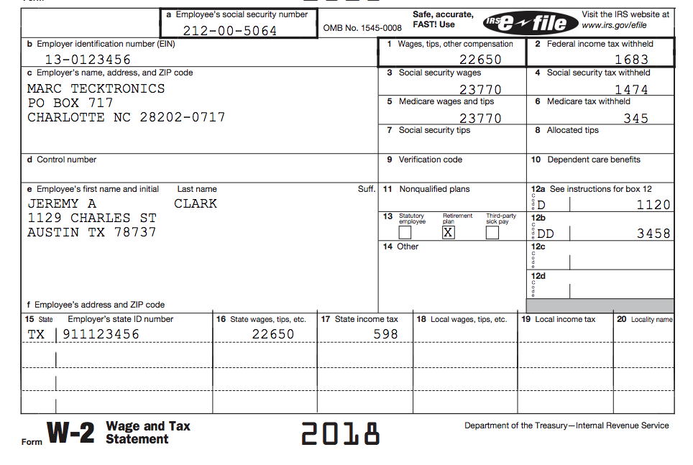
Verify W-2 information
Code D may mean a retirement Savings Credit is present which should be verified
Does the address match the taxpayer’s W-2?
Notes:
Verify W-2 information
Quality Reviewers should not only verify the accuracy of the data entries, but also should think about what else the form may telling them (e.g. Could there be a Retirement Savings Credit, a Childcare Credit, HSA adjustment, etc.

Slide 34
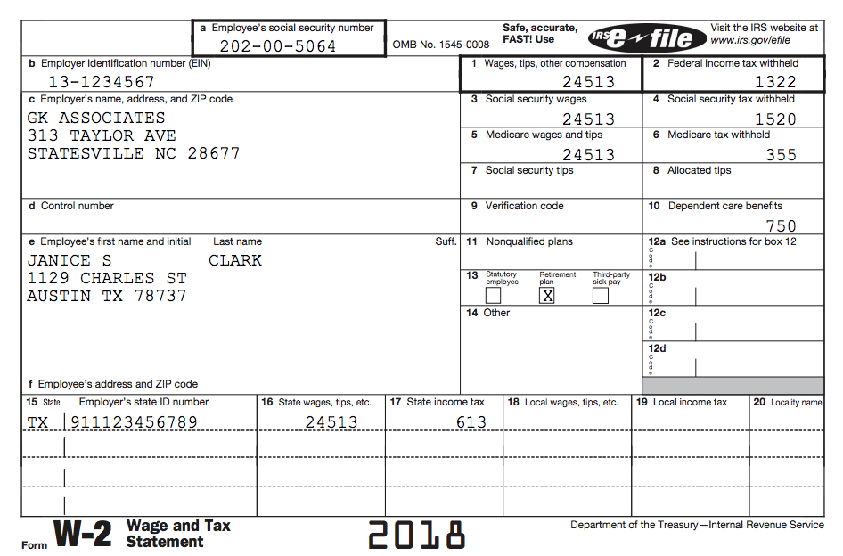
Verify W-2 information
Second W-2
Verify information matches paper document
Notes:
Verify W-2 information

Slide 35
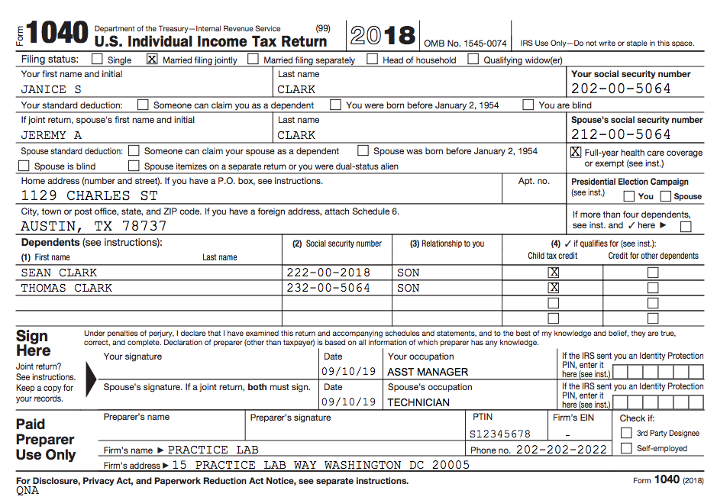
Review Form 1040
Verify check boxes here
Verify occupations and IPPIN
Notes:
Can review 1040 form here
This is a good point to compare with last years return and to see if taxpayer(s) have any questions

Slide 36
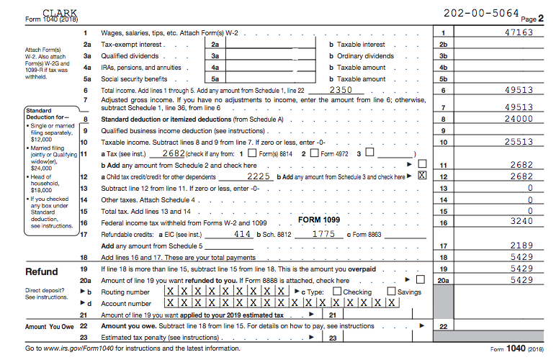
Page 1 of Form 1040
Is the Standard Deduction correct?
Do the CTC and ACTC look correct for two children under age 17?
Verify Bank Information

Slide 37
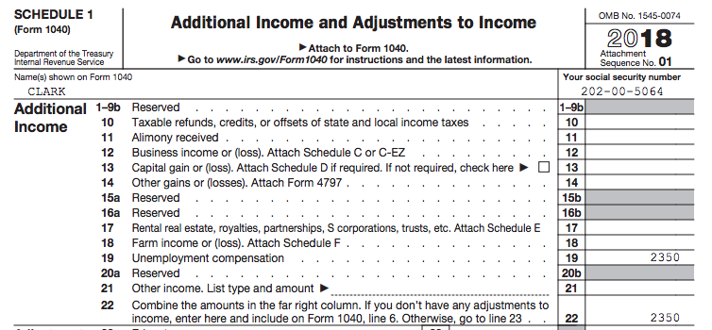
Review Schedules (Number will vary by year)
Is state refund taxable?
Unemployment
Notes:
Unemployment from spouse’s 1099-G
If state refund is listed, verify that it is taxable
Note that self-employment from Schedule C, Rent from Schedule E, and Other Income (gambling, cancellation of debt, jury duty, poll worker, etc.) would all show up here
Instructor: Ask learners what might be out of scope, or require special certification

Slide 38
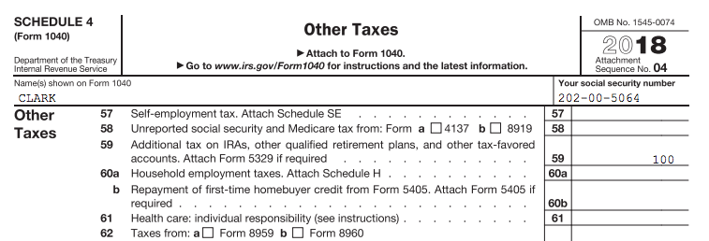
Review Schedules
What are ways these taxes could be lowered?
Notes:
If taxpayer has Excess advance premium tax credit repayment, can they lower their income to reduce repayment? Contribute to IRA or HSA?
If taxpayer has Additional tax on IRAs, is there an exception that would apply?
Instructor: Ask learners what might be out of scope, or require special certification

Slide 39
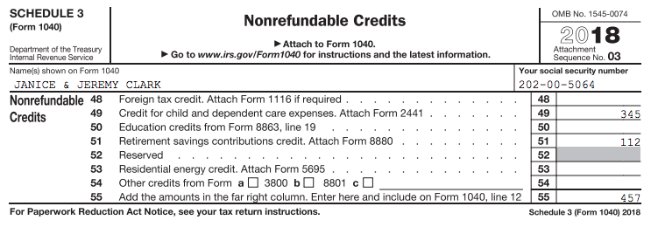
Review Schedules
Do non-refundable credits agree with taxpayer documents and situation?
Notes:
Child Care Credit from Form 2441,and Retirement Savings Credit from Form 8880
The non-refundable Child Tax Credit and Credit for Other Dependents shows up on 1040

Slide 40
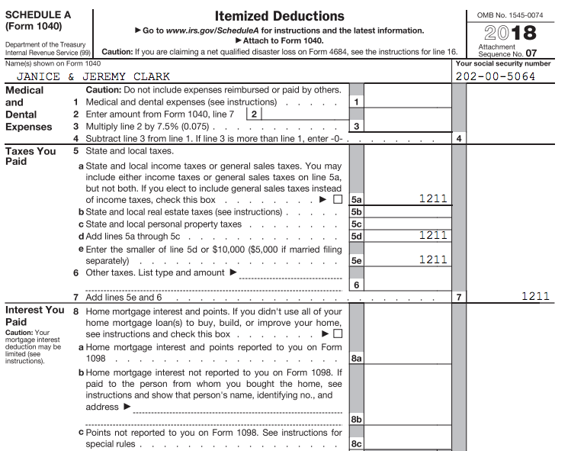
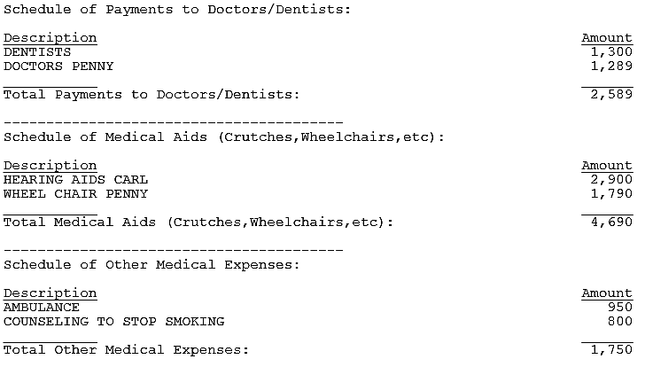
Review Schedule A
Itemized deductions can be verified on Schedule A
QR print set also includes detailed entries (medical, charity, etc.)
Notes:
Instructors should stress to learners to use the “scratch pads” in TaxSlayer when entering itemized deductions. Then, the Quality Reviewer can review those entries in the QR print set rather than going back into the return

Slide 41
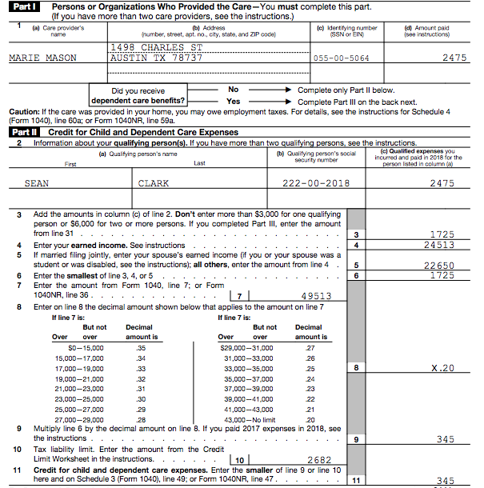
Child Care Credit
Verify information matches taxpayer documents
Carries to Schedule 3

Slide 42
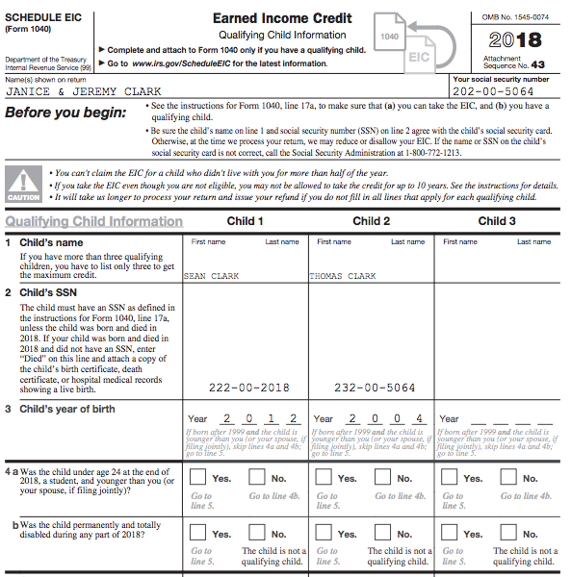
Review Schedule EITC
Verify all appropriate Qualifying Children entered for EITC
Verify boxes in the Personal Information Section are correct marked

Slide 43
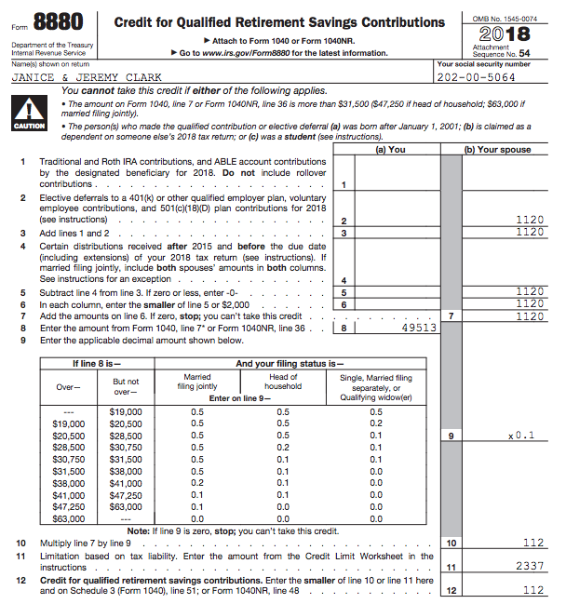
Review Form 8880
Did any pension distributions need to be subtracted (e.g. military)?
Jeremy had a code D on his W-2. Carries to Schedule 3

Slide 44
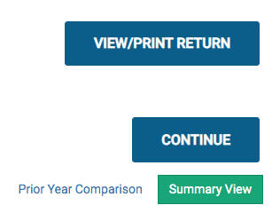
Compare Current and Prior Year Returns
TaxSlayer has a Year to Year comparison
Summary/Print screen
Major differences:
Refund went up due to tax law changes
Dividends $120 last year, none this year
Wages went down $1,000
Notes:
Why did these numbers change?
Instructor: What questions to ask taxpayer regarding these changes?

Slide 45
2017 Tax Return
2017 Tax Return
2018 Tax Return
Missing 1099-DIV?
Dividends

Slide 46
Summary
The QR Print Set is a useful tool for verifying the accuracy of the return
The need to examine individual data entry pages inside the return can be minimized if not eliminated altogether
Counselors can assist Quality Reviewer by using the itemized amount detail in TaxSlayer
TaxSlayer Detail Icon

Slide 47
QR Saves the Day
Real Life Cases
Notes:
The following slides describe real scenarios seen at tax sites where the Quality Review “saved the day”
They illustrate that a good QR is not just a proof reading exercise, but needs to be a critical look at the return and continued dialog with the taxpayer to ensure the accuracy of the return

Slide 48
QR Saves the Day
Following cases are real life examples
QR “saved the day”
Notes:
The Quality Reviewer is not only a certified Counselor they are also an expert, teacher, mentor, teammate and more

Slide 49
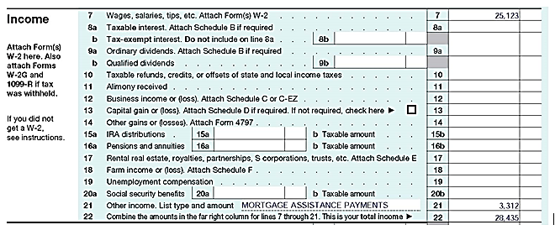
Case 1 – Just because there is a form………..
Page 1 of Form 1040 reviewed in the QR Print Set
Reviewer noted taxpayer provided the Form 1098-MA
Payments not taxable, but Form 1098-MA is out of scope!
What do you think?
Notes:
In this case the preparer did not consult the Tax-Aide Scope Manual and just assumed this was income that should be entered on the return

Slide 50
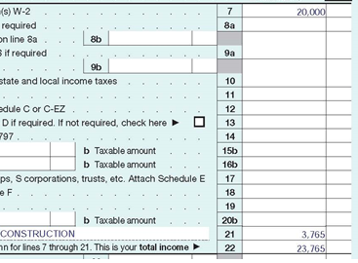
Case 2 – Accepting things at face value………..
Page 1 Form 1040 was being reviewed in the QR Print Set – and the reviewer noted this
The taxpayer had a 1099-MISC with entry in Box 3
Taxpayer worked part-time for a contractor doing construction work
What probing questions should be asked?
Notes:
Employers do not always enter income in the right place on a 1099-MISC a conversation with the taxpayer is essential

Slide 51
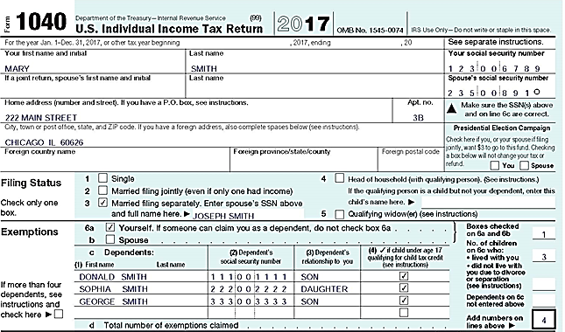
Case 3 – Taxpayers don’t know all the rules
>Taxpayer filed MFS in the past
>Last year separated
>Lived apart the last 8 months of the year
>Children lived with her
>Met requirements for HoH
What probing questions should be asked?
Notes:
The taxpayer said, “We have always filed Married Filing Separately”
Is there a better filing status? Children live with her and she lived apart from spouse all year
Instructor: Could be HOH

Slide 52
Case 4 – Why the QR does an interview
Part II, line 2, of the Intake Booklet handed to the QR
Single return claiming no dependent or nondependent:
Notes:
Instructor: Have learners use Bogart to determine if the taxpayer can claim any credits based on his brother. Answer: EITC
In this case the taxpayer assumed that the brother would have no effect on their return because the brother provided his own support

Slide 53
Case 4 – The rest of the story
Same intake sheet after the QR updated the Intake Booklet:
Taxpayer, single, worked only part-time (wages $21,355) cared for disabled brother
Brother is qualifying child for the EITC
EITC went from zero to $2,925

Slide 54
Case 5 – It’s not always that simple
Part III of the Intake Booklet handed to the quality reviewer:

Slide 55
Case 5 – The rest of the story
Return looked so easy: Single guy age 28, one W-2 for $28,000 wages. What should you ask?
QR: So, you just had one job last year?
Taxpayer: I did some seasonal work delivering packages during the holidays, but didn’t get a tax form and I don’t think that they took out much in taxes anyway.
QR: You need to report that income, too. Maybe you can get access to the W-2 online?
Taxpayer: Maybe. I think it went to my dad’s house.

Slide 56
Case 5 – The rest of the story (part 2)
QR: Did you have any other income?
Taxpayer: Last summer I worked construction for about a week and it paid well. But they just gave me cash. I earned $1,200.
QR: That needs to be reported, too. Did you have any expenses related to the construction work? When you come back with that W-2, I need to know about that construction job, how much you were paid and the amount of any expenses

Slide 57
Case 5 – The Updated Intake Booklet
Here is the updated Intake Booklet:
Check box 7
“Yes”

Slide 58
Case 6 – Leave no question unanswered
Part VI of the Intake Booklet handed to the quality reviewer:
Same Intake Booklet after the quality reviewer update:

Slide 59
Case 6 – The rest of the story
Taxpayer received IRS letter for a prior year about claiming her grandchildren as dependents and as qualifying children for the EITC and child tax credit
Taxpayer needed help responding to IRS inquiries
Referred to a Low Income Taxpayer Clinic (LITC)
Completed Form 8862, Information to Claim Certain Refundable Credits After Disallowance to file with 2017 return

Slide 60
Case 7 – Taxpayer did not read fine print
Part II, line 2, Intake Booklet handed to the quality reviewer:
Intake Booklet after the quality reviewer’s interview:
Notes:
In this case the taxpayer came in in March but neglected to read “As of December 31, 2017 were you….”
Instructor answer: Taxpayer is eligible to file MFJ; Taxpayer and ex-spouse agreed to file MFJ one last time

Slide 61
Quality Review
Questions?
Comments…

